Slide 1
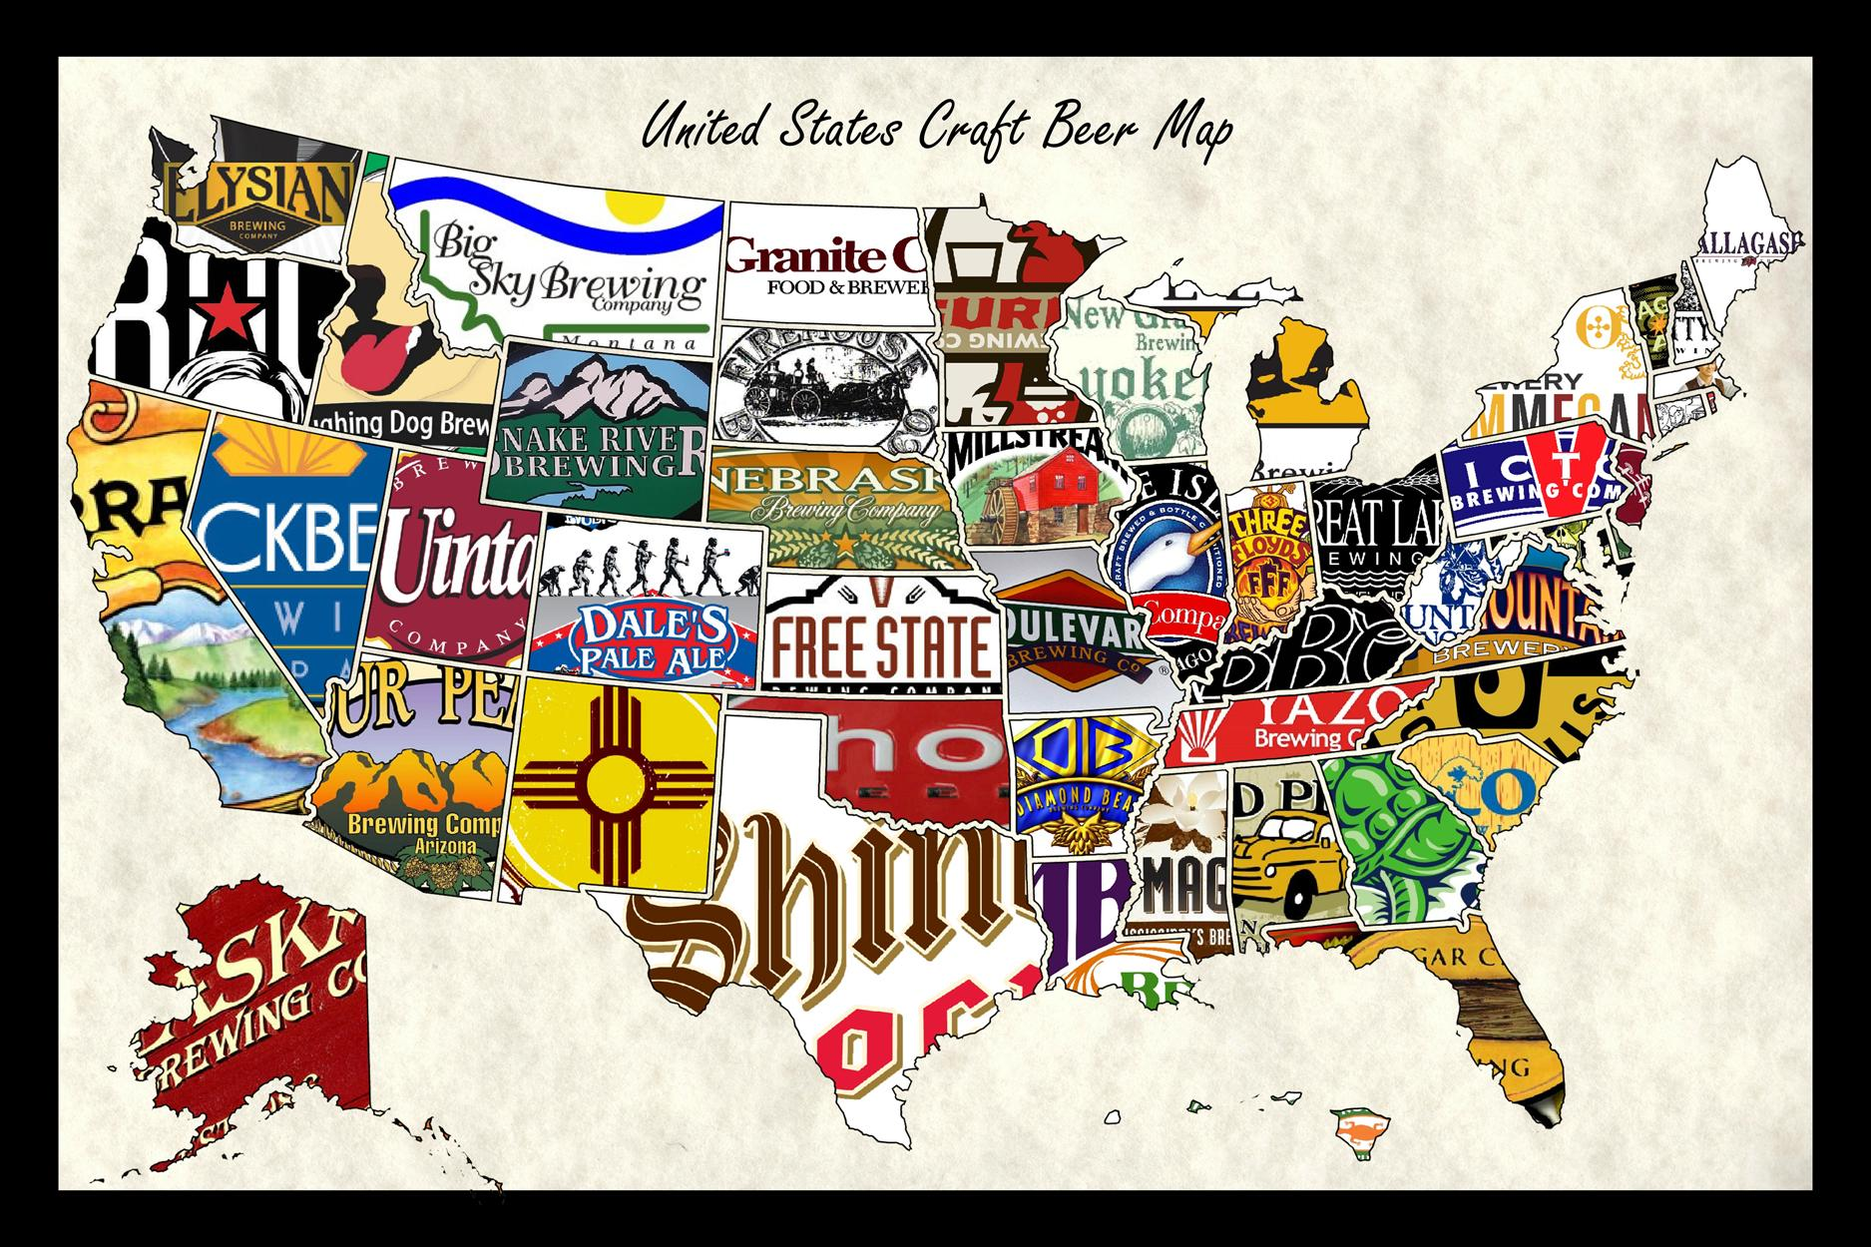
Brewmasters
Tyler, Stew, Matt, Lauren
Notes:
Matt

Slide 2
Question
Extension Question
Does average income level affect the number of breweries in a given zipcode/state in the United States?
Based on correlations between average income and number of breweries, where should an entrepreneur open a brewery?
Notes:
Matt

Slide 3


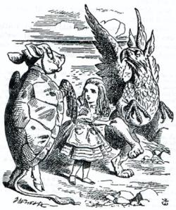

Data Collection
Irs.gov income data
Brewers Association
Beautiful Soup
Geocode API
Notes:
Matt

Slide 4
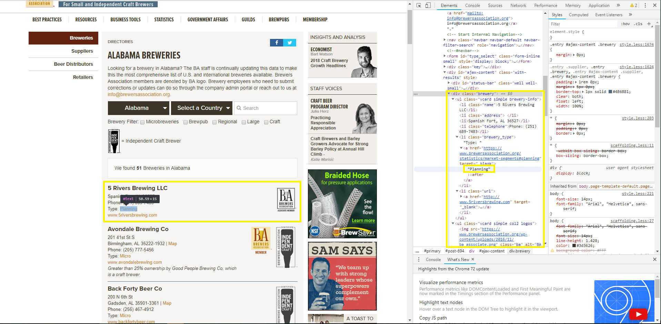
Scraping with BeautifulSoup
Notes:
Tyler (15-30 seconds)
Able to retrieve HTML and parse

Slide 5
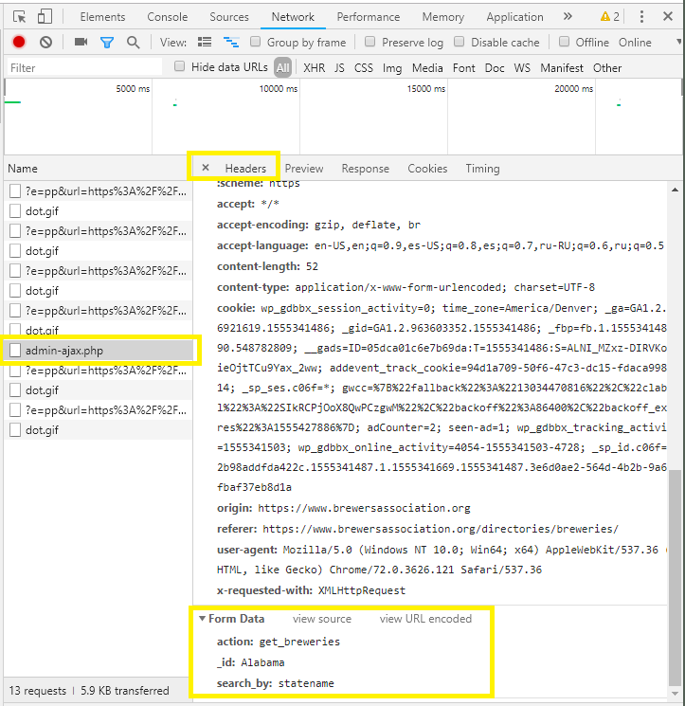
Scraping with BeautifulSoup
The Libraries
import requests
import bs4
import re
The Request
requests.post('https://www.brewersassociation.org/wp-admin/admin-ajax.php',
data= {
"action": "get_breweries",
"_id": state,
"search_by": "statename"
})
Notes:
Tyler (1 min)
Libraries
Requests to make request
bs4 for easier parsing of HTML
re for locating string patterns
Request
post() instead of get()
Making request to database
data= {} similar to params= {}

Slide 6
Scraping with BeautifulSoup
The Soup
soup= bs4.BeautifulSoup(response,"html.parser")
Picking through the Soup
breweries= [soup.find_all(attrs= {"class":"brewery"}) for soup in soup_list]
Regex
p= re.compile("<li>(.*?), ([A-Z][A-Z]) (\d{5})?")
ZIP_Code= re.search(p, str(city_state_zip)).group(3)
Notes:
Tyler (1 min)
Turn response into BeautifulSoup object
Allows for prettification, parsing, etc
Add all brewery classes from HTML to a list for iteration
RegEx
Compile pattern to look for
<li>: List item in HTML
(): Creates groups
Example: .group(3)
(.*?),: Searches for any number of any characters preceding a comma
[A-Z]: Searches for capital letters
\d{5}: searches for 5 digits

Slide 7
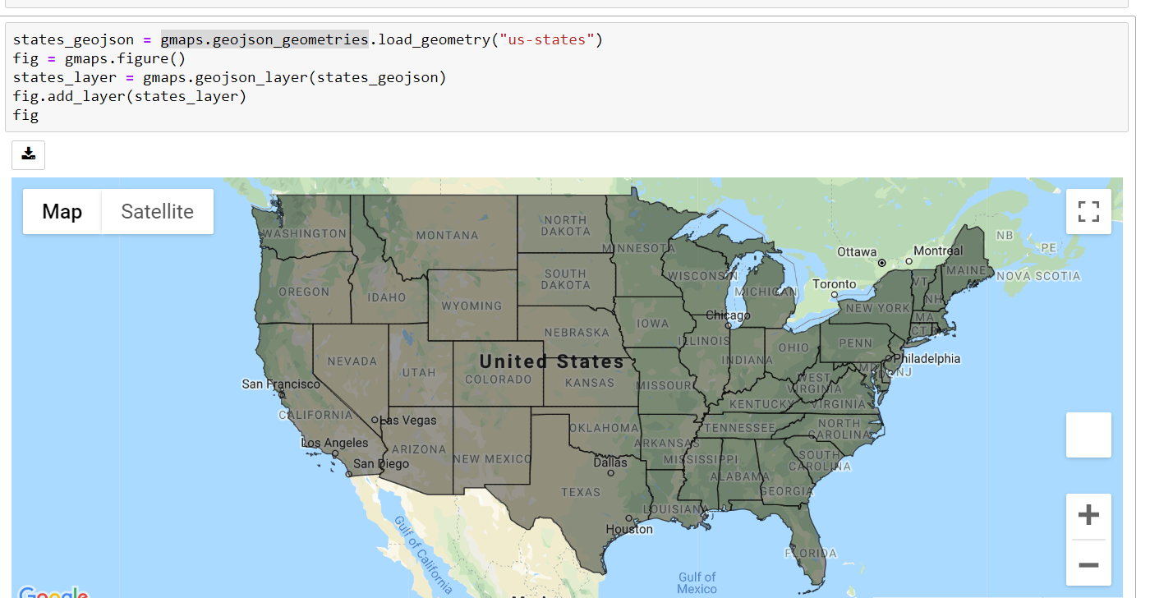
Geojson_geometries
Notes:
Stew (30 s)

Slide 8
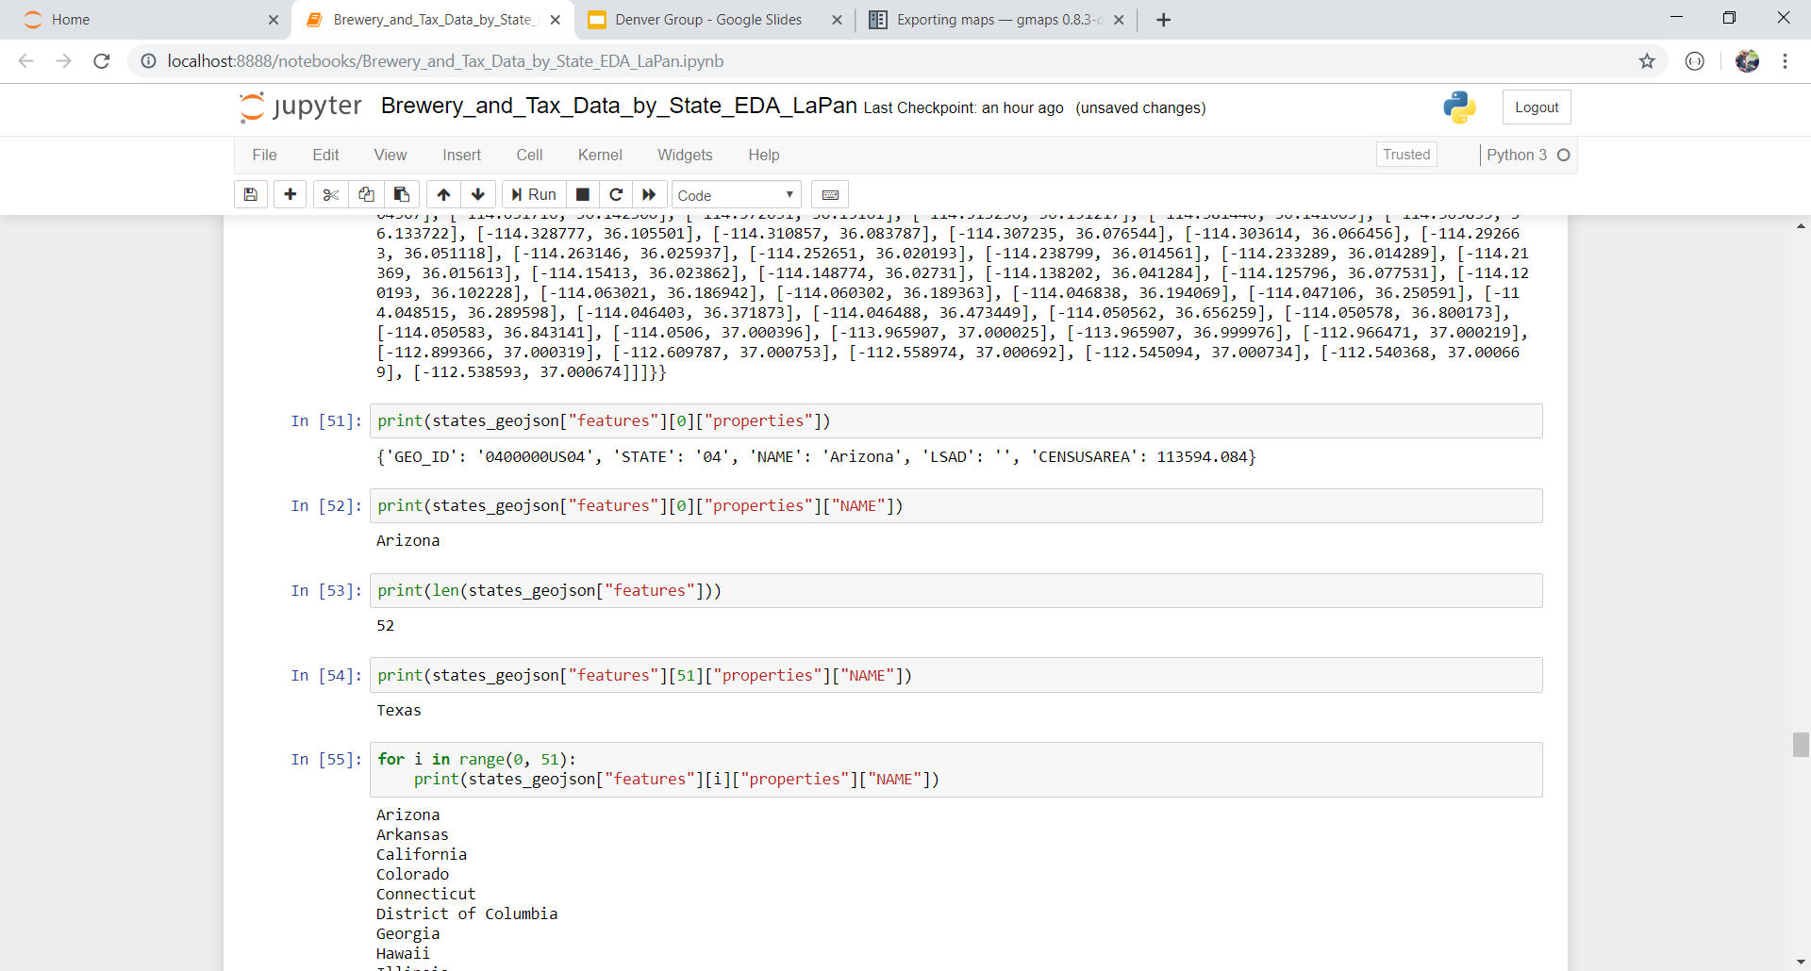
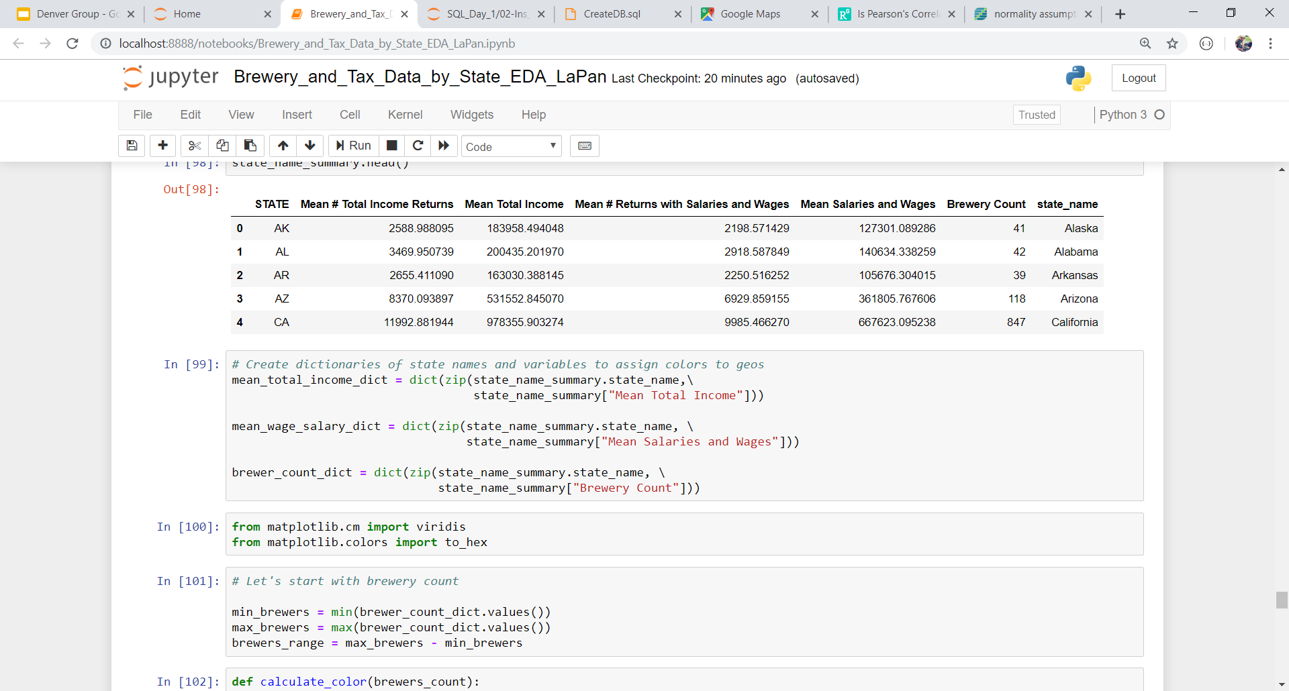
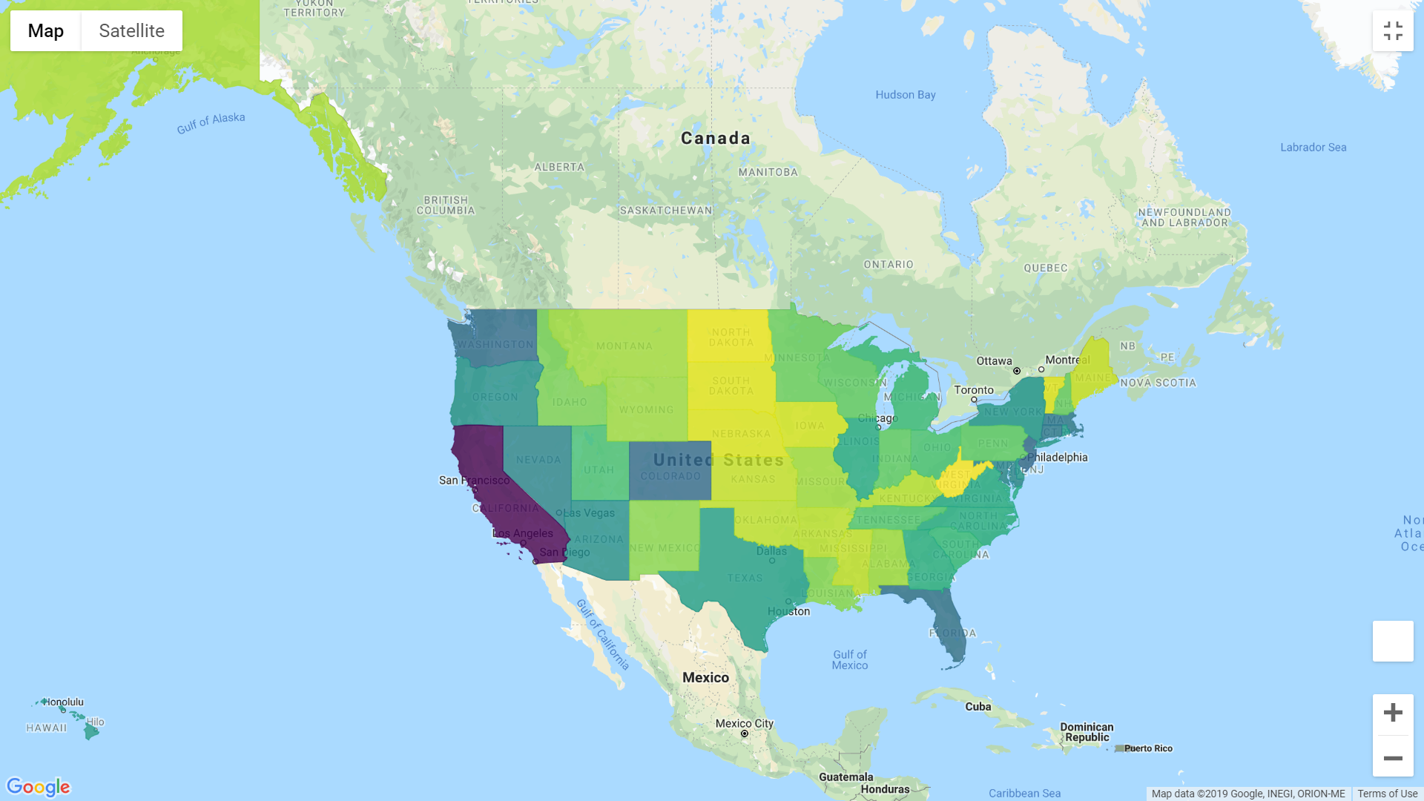
Notes:
Stew (30 s)

Slide 9
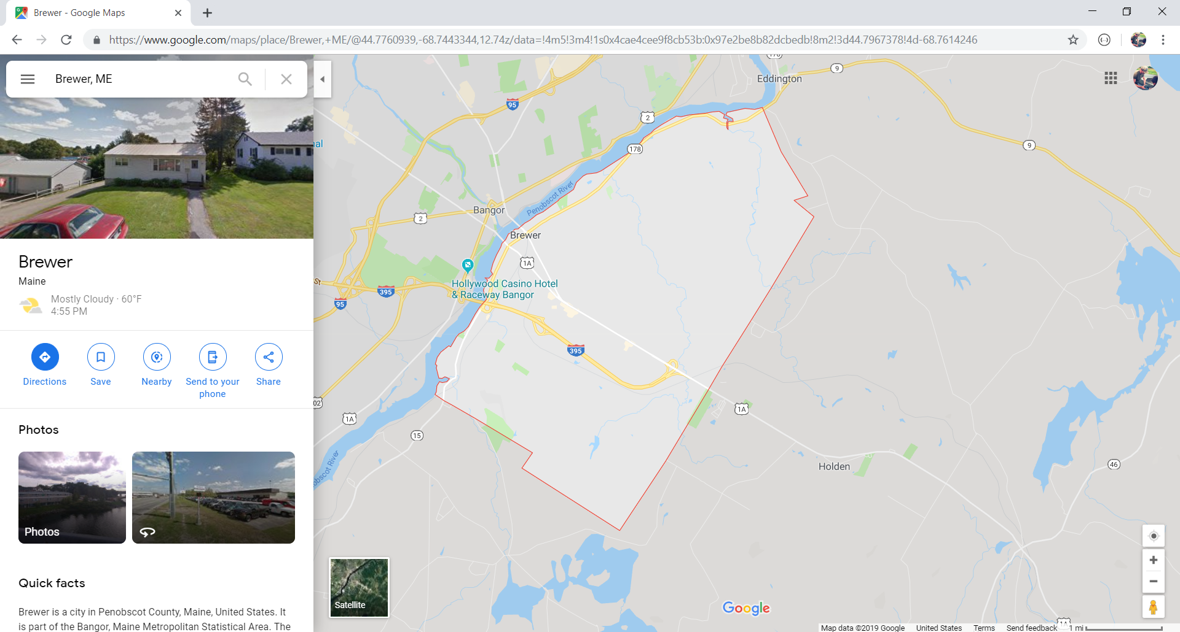
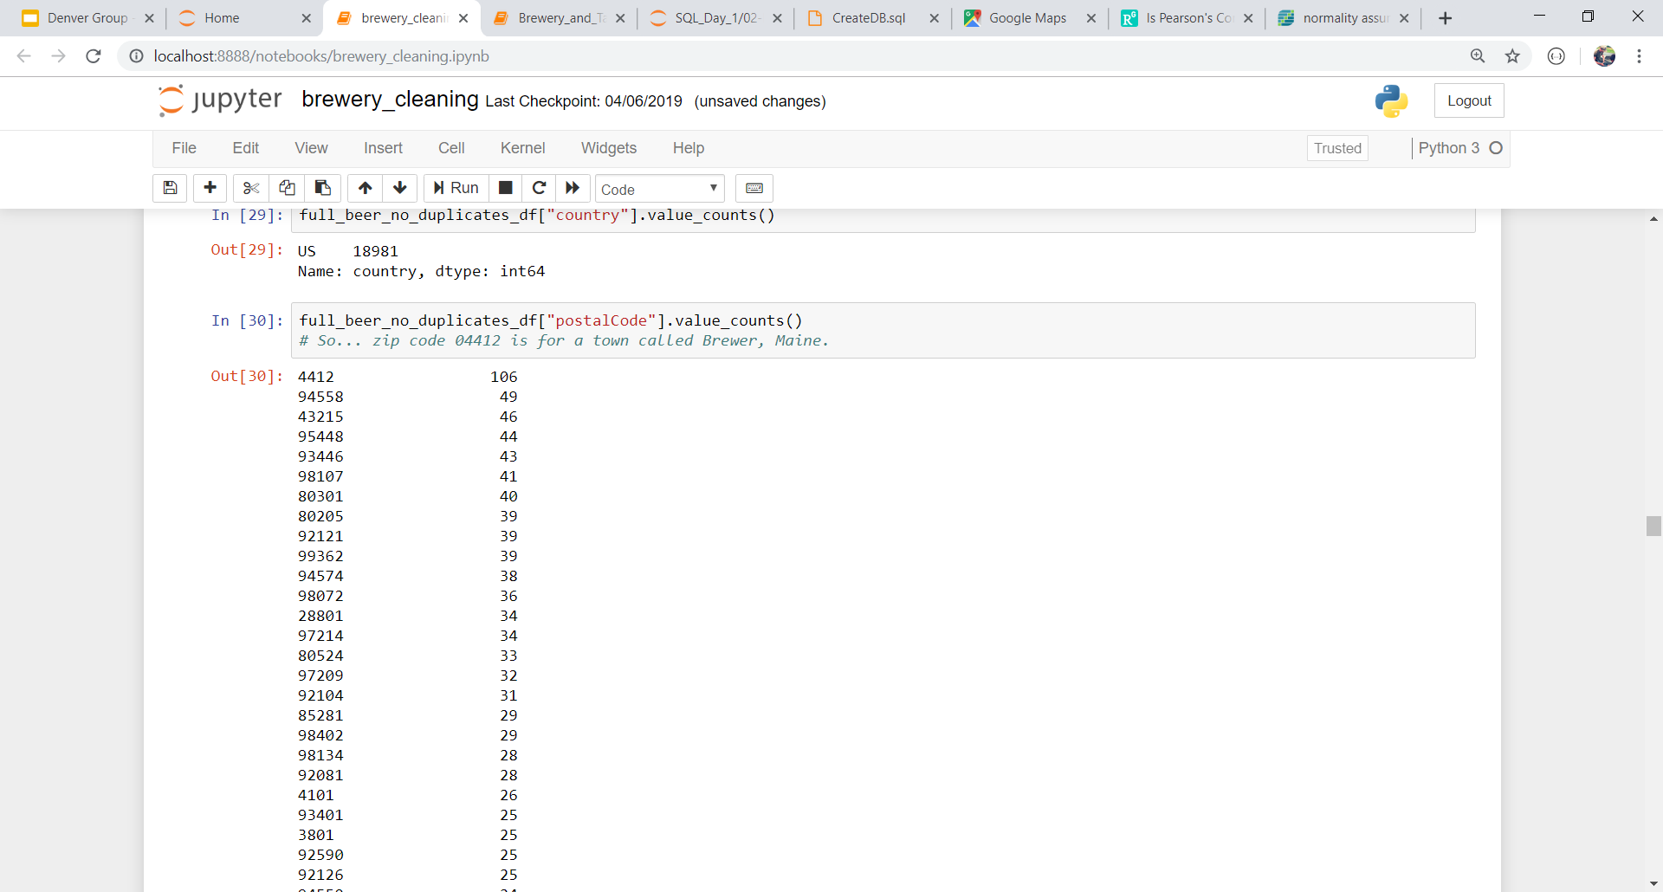
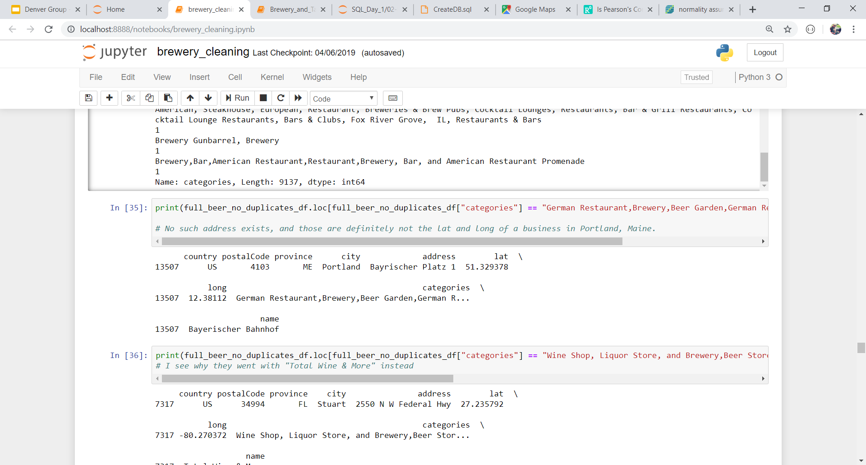
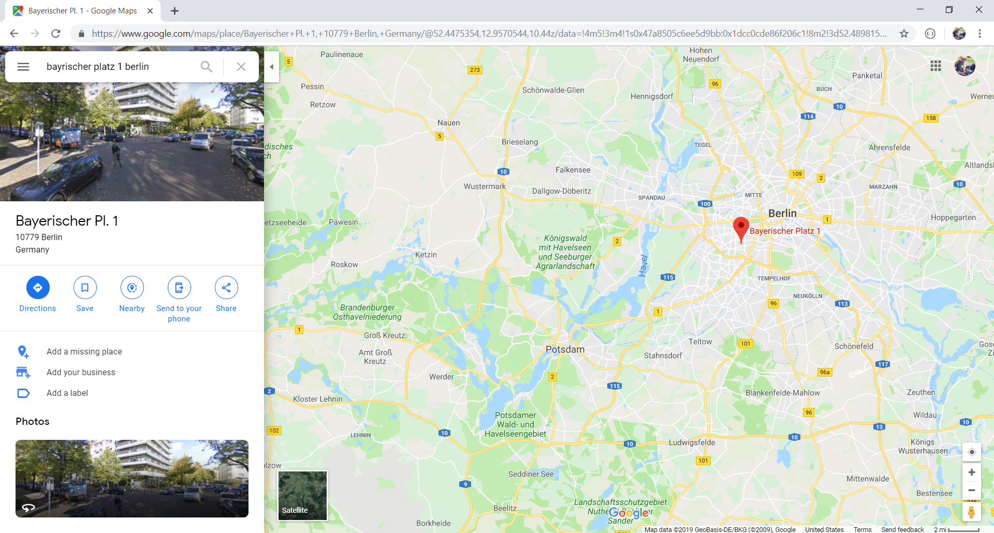
Data Limitations
Notes:
Programmatic data exploration won’t always turn up every error…
Stew (1 min.)

Slide 10
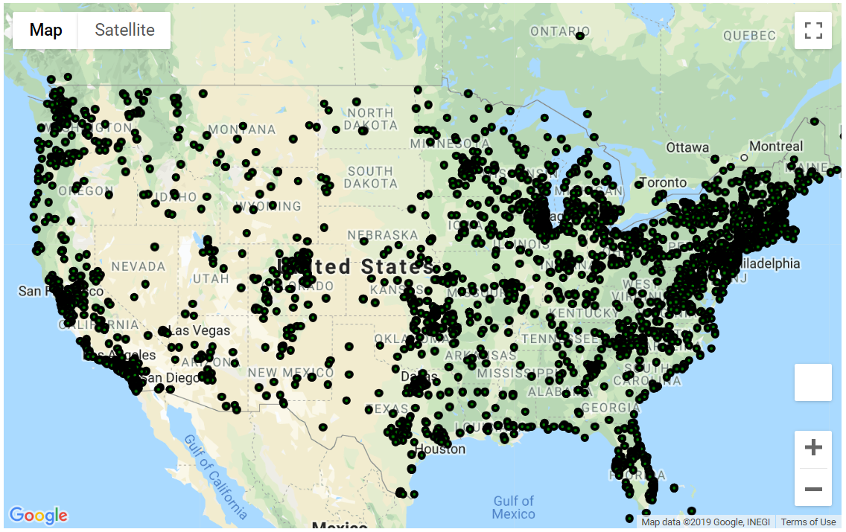
Data Exploration - gmaps
Notes:
Lauren - 15 seconds

Slide 11
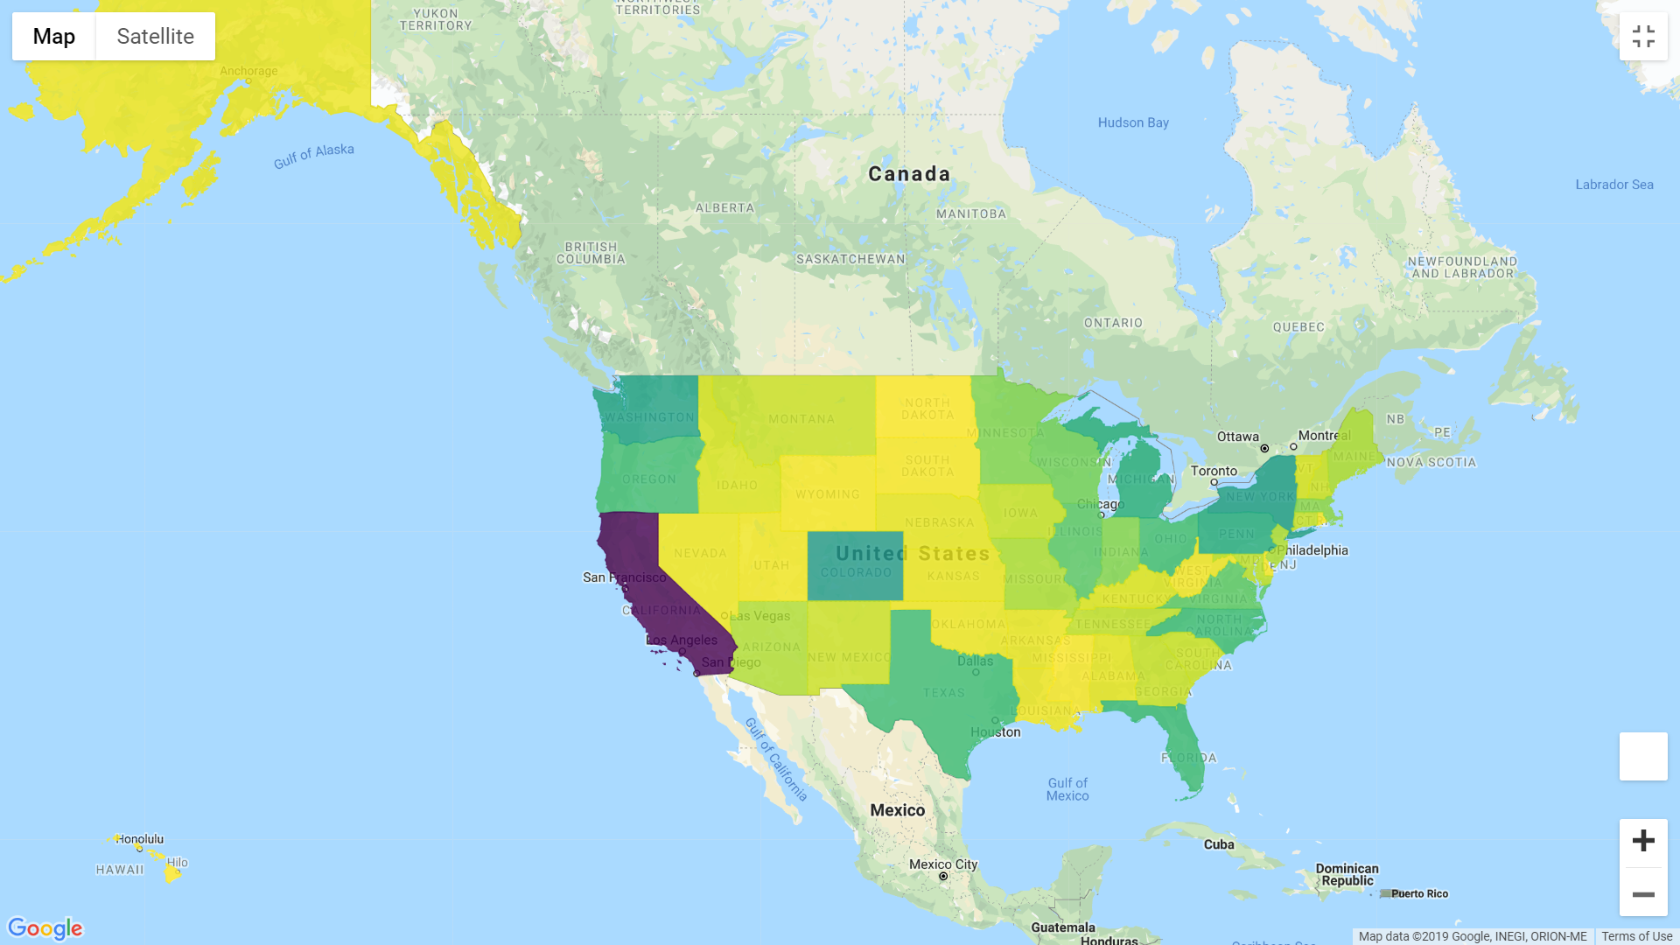
Brewery Count by State
Notes:
Lauren - 15 seconds

Slide 12
Mean Income by State
Notes:
Lauren - 20 seconds

Slide 13
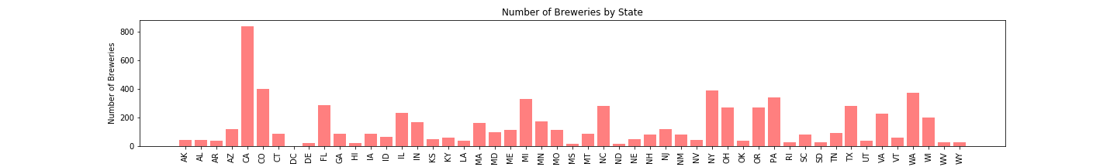
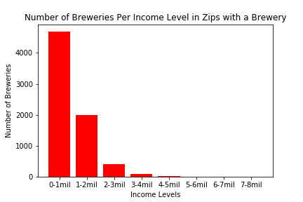
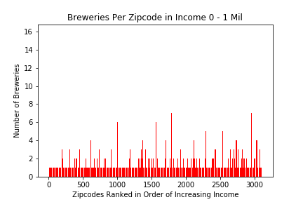
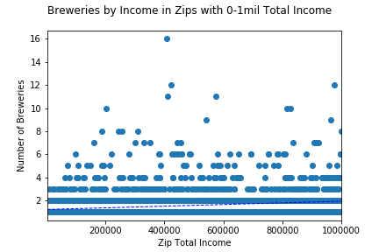
Data Exploration - Charts and Regression
r = 0.182, p = 9.37e-08
Notes:
Lauren - 1.5 minutes

Slide 14
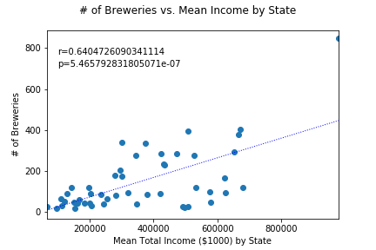
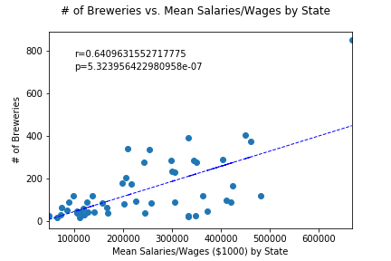
Regression Data
Notes:
Stew (1 min)
R = coefficient of correlation

Slide 15
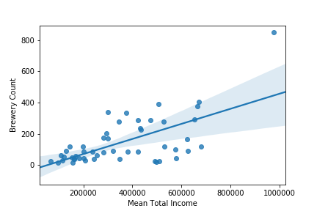
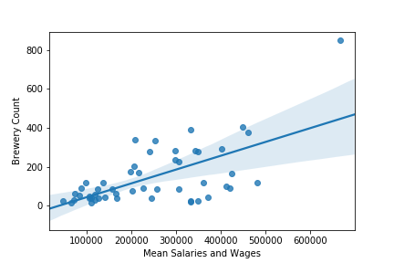
Regression Data
Notes:
Stew (30 s)

Slide 16
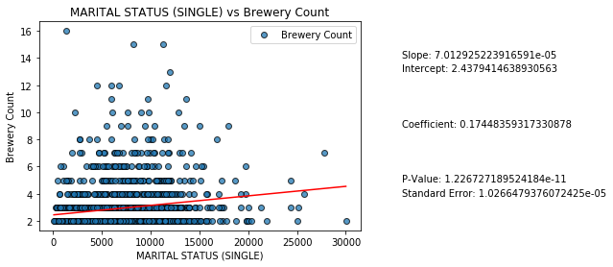
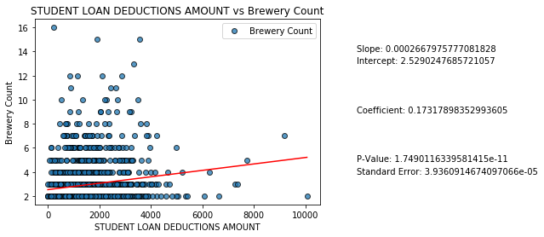
Conclusion & Discussion
What went well, what didn’t go well, what would we change with hindsight
We need more data!
More demographic data (i.e. age, ethnicity, etc.)
Data for non-residential/business districts
Notes:
Tyler/Matt?
While the statistics aren’t significant, some fields of the tax information stand above the others as predictors for areas that support more breweries; these would likely be the best candidates for further investigation into this question.
Single Status Coefficient= 0.174
Student Loan Deductions Coefficient= 0.173

